Slide 1


LEARNING STATISTICS IN EXCEL

Slide 2

George Mount
Data Analyst & Educator at Stringfest Analytics
George works as an independent analyst and data analytics educator with the goal to help clients manage their data so they think more creatively. He serves as a technical expert and lead curriculum developer for Thinkful’s data analytics program and is the instructor of the DataCamp course “Survey and Measure Development in R.”
George blogs about data, innovation, and career development at georgejmount.com. He holds a master’s degree in information systems with a certificate of achievement in quantitative methods from Case Western Reserve University

Slide 3
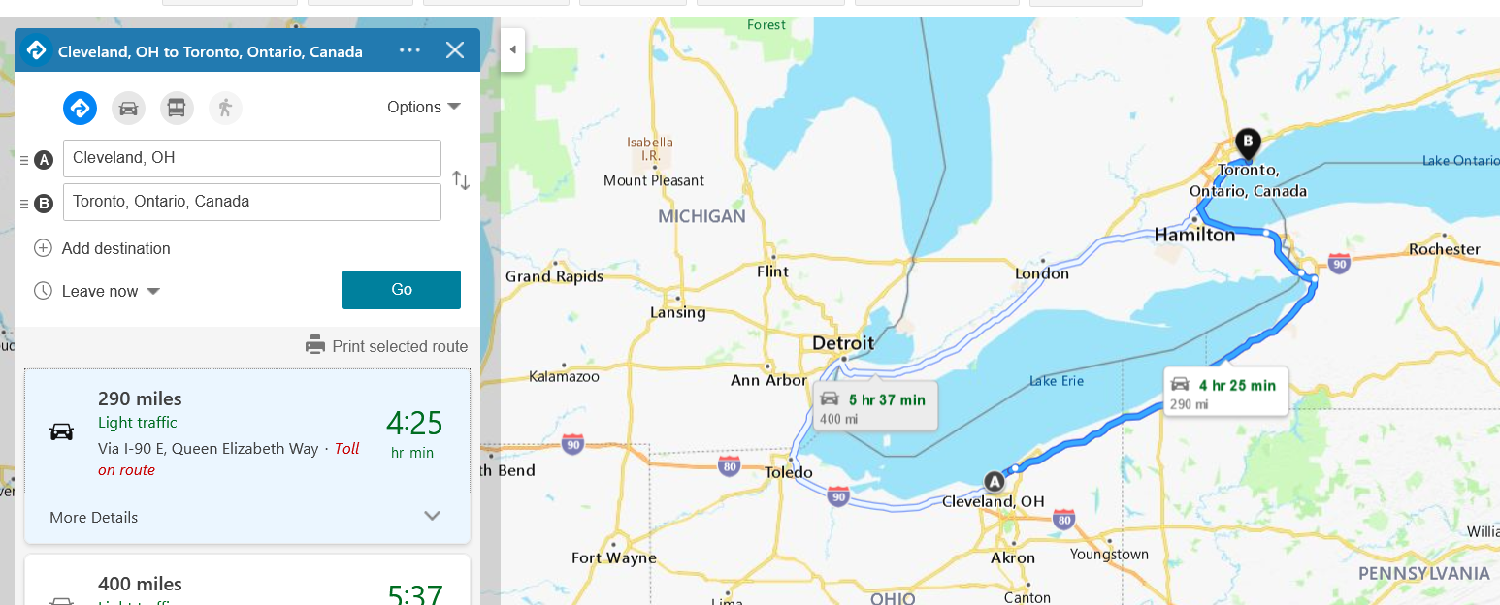

Notes:
I’m actually not that far from you all, there is no way it’s only 4 hrs 25, more like 7. But anyway I was up there last year and met Celia and we all hoped I could get to a meetup! Well that’s not happening but we can do this at least!

Slide 4
OBJECTIVES FOR TODAY
Normality explained
Normality and statistical inference
Sampling and the margin of error
Conditional probability
Next steps for learning statistics
Learning Statistics in Excel
Notes:
Objectives for our time together – I want to illustrate some of the key theorems of statistics that underlie data analytics and data science. And not just lecture them to you, make these interactive by using Excel. So we will start with normality and what the normal distribution really does for us.
We will then look at the link between normality and statistical inference, this is how do you take a sample and make claims about a population?
This will always involve sampling and sampling error, so we will look at the margin of error and what is actually meant when you hear that term.
Finally if we have time we will look at conditional probability and how when we are dealing with one event in the presence of another, things work a little differently, we’ll be using a famous example again from real life.
And then bring it back to what your next steps for learning stats might be.

Slide 5
PREREQUISITES
Familiarity with descriptive statistics (mean/median/mode, standard deviation/variance)
Experience with intermediate Excel functions (MATCH(), nested IF() statements, etc.)
Ability to insert and modify Excel charts
Learning Statistics in Excel
Notes:
Ideally for you to get the most out of this workshop, you will have some familiarity with descriptive statistics, if you’ve heard of things like the mean, median mode and standard deviation/variance, you should be in good shape.
It would also be great if you can handle some intermediate Excel functions such as MATCH and nested IF statements, this will be very useful for how we wrangle and set up this data.
And we’ll also be visualizing most of this data so some comfort with using charts will be helpful.

Slide 6
FOLLOWING ALONG
Workshop repo: https://github.com/summerofgeorge/stats-ms-excel-toronto
Each section is a sub-folder
Demos = follow along with me
Refresh your memory with the demo notes
Learning Statistics in Excel
Notes:
I want this to be as interactive as possible, if you’ve got two screens you’re welcome to follow along with me! You can download all the resources at the repo, things are broken into sections. I have all the files we’ll use as well as notes for the workshop, I have these notes loaded up on my iPad and I’ll be looking at them here.

Slide 7

WHY WOULD WE DO THIS IN EXCEL?
“You get to look at the data every step of the way, building confidence while learning the tricks of the trade.”
-- John Foreman
Excel Statistics for Business Analytics
Notes:
With the rise of data science programming in R and Python it seems silly to want to do this in Excel but we can really get hands-on this way. We get a lot more up close and personal analysis of the data.

Slide 8

https://georgejmount.com/why-excel-is-the-best-way-to-learn-data-analytics/
Notes:
Here is a blog post explaining my reasoning behind why do this in Excel.

Slide 9
1. NORMALITY EXPLAINED
Notes:
OK let’s start with looking at what normality actually means and what it tells us.

Slide 10
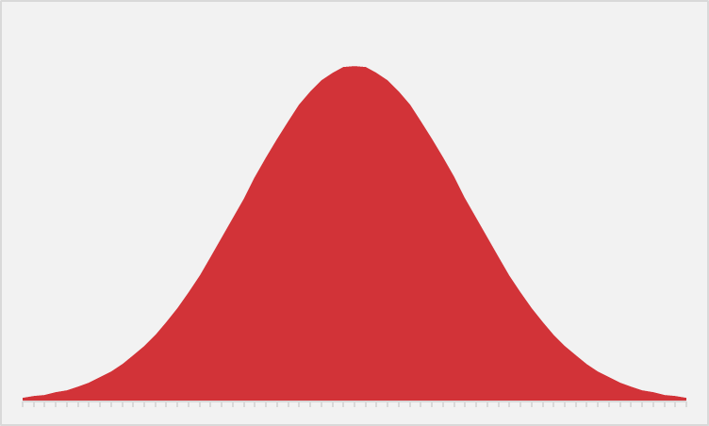
EVER WANTED TO JUST BE NORMAL?
STATISTICS IS YOUR CHANCE.
Notes:
The normal distribution of paramount in statistics. We are able to extrapolate pretty well about a variable’s value when it falls on a bell curve because we know exactly how “spread” the variable’s values are around its center.
Next slide for some specifics.

Slide 11
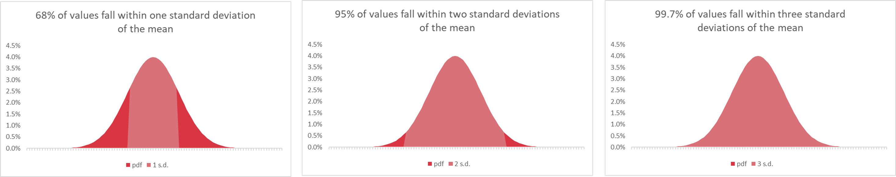
WHAT DOES IT MEAN TO BE NORMAL?
“Empirical rule”
Notes:
This is called the empirical rule and it tells us how many observations we expect to fall within how many standard deviations of the mean. We can expect that 68% of our observations fall within 1 standard deviation, 95% within 2, and 99.7% within 3. This allows us to state how likely or unlikely it is to get any certain value.

Slide 12
DEMO
Demo: empirical-rule.xlsx
Probability mass function : tells us what percent of observations we expect to find for a given value of our distribution
e.g. We would expect to find about 3.7% of observations to equal 54 for a normally-distributed variable with a mean of 50 and standard deviation of 10
Notes:
Let’s take an example here, and don’t forget about the demo notes!

Slide 13

QUESTIONS?
Notes:
Any questions? I hope this was a helpful illustration of how normal distributions work.
Keep in mind that Excel has many other functions for building probability distributions, such as the binomial or the Poisson. Worth checking out to help solidify your knowledge of distributions! Very important topic.

Slide 14
2. NORMALITY AND STATISTICAL INFERENCE
Notes:
OK, now that you have a grasp on how the normal distribution works, let’s move on to its relationship to statistical inference. You will see that the normal distribution forms a sort of missing link between our sample and our population.

Slide 15

STATROULETTE
A roulette wheel returns values between 0 and 36.
Let’s simulate a game of roulette in Excel
Notes:
Instructions follow on the next slide.

Slide 16
DEMO
central-limit.xlsx
First:
Simulate 500 rounds of a roulette spin.
Plot the resulting frequency distribution as a histogram.
Then:
Simulate a roulette spin 100 times.
Take the average spin.
Do this for 500 trials.
Plot the distribution of trial means as a histogram.
Notes:
Head to the demo notes for a step-by-step instruction

Slide 17

MAGIC… OR STATISTICS?
Central limit theorem: the sampling distribution of the mean of any independent, random variable will be normal or nearly normal, if the sample size is large enough.
Notes:
Magic, or statistics? This is courtesy of the central limit theorem. Sample means tend to normality, which means since we know the probability distribution, we can make reliable estimates about a population, given a sample, as we extrapolate to that population.

Slide 18
How “large enough” is large enough?
N = 30? 60? 100?
It depends on how “normal” your sample is
Notes:
The big caveat is that a sample has to be “large enough.” What does that mean? Well, the base case is 30. 60 is better and 100 is even better. If your data’s sample is already looking normal, it’s going to take a smaller sample size to hit that “large enough” qualification. So generally a normally distributed variable is considered a requirement to do these statistics in practice, whereas in theory this is not such a dead-locked requirement.

Slide 19
DEMO
large-numbers.xlsx
A roulette wheel returns values between 0 and 36.
What is the average roulette spin given more and more spins?

Slide 20
MAGIC… OR STATISTICS?
Law of large numbers: the average of results obtained from trials become closer to the expected value as more trials are performed
Notes:
So now you see that the central limit theorem tells us that our sample means are going to be normally distributed around the population mean, and the law of large numbers tells us that as our sample increases, we should find what that population mean actually is.

Slide 21
QUESTIONS?
Notes:
So far so good? Let’s look at an important case study as we in the US are in an election year.

Slide 22
3. SAMPLING AND THE MARGIN OF ERROR
Notes:
OK, let’s take a look at this relationship between our sample and the margin of error.

Slide 23

DEMO
File: margin-of-error.xlsx
Pollsters often report a “margin of error of +/- 2-3%.”
What does that mean?
Notes:
What does the margin of error actually mean?

Slide 24
QUESTIONS?
Notes:
Thoughts on the margin of error?

Slide 25
4. CONDITIONAL PROBABILITY
Notes:
OK now this section is quite different. We are going to look at how probabilities are affected by prior information that we possess.

Slide 26
Notes:
Everybody ready for a game?

Slide 27
Notes:
Let’s play let’s make a deal! Scenario is on the next slide and then we’ll jump into Excel.

Slide 28
DEMO
monty-hall.xlsx
Three doors: one car, two goats
You pick a door
Monty opens another door: it has a goat
Do you stick to your door, or switch doors? Does it matter?
🚪🚪🚪
🐐🚗🐐
Notes:
Now take a moment to enter in the chat what you think we should do. And then we will demo it in Excel.

Slide 29
https://www.youtube.com/watch?v=4Lb-6rxZxx0
Notes:
I find this GIF super helpful in understanding what is happening here. Our probabilities change based on the information we received about our priors. This is where Bayesian statistics comes in, something to check out if you are interested.

Slide 30
QUESTIONS?
Notes:
That one was a doozy, any questions?

Slide 31
4. CONCLUSION
Notes:
Thank you everybody for tuning in today, looking forward to having some socializing here at the end!

Slide 32
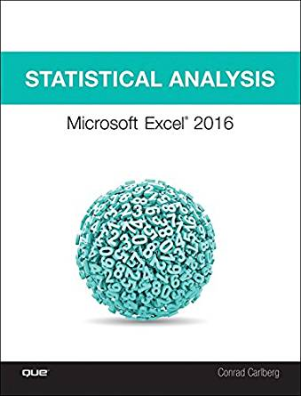
Statistical Analysis: Microsoft Excel 2016, by Conrad Carlberg
On O’Reilly Learning at https://learning.oreilly.com/library/view/statistical-analysis-microsoft/9780134840437/
Human Centered Design • MDLS 2020
Notes:
First, this is a pretty comprehensive look at doing statistics in Excel, this will indeed take you all the way through into linear regression, using Excel.

Slide 33
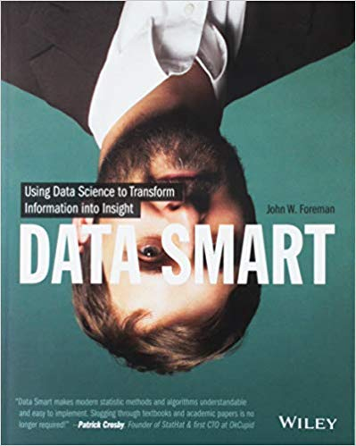
Data Smart: Using Data Science to Transform Information into Insight,
by John Foreman
On O’Reilly Learning at https://learning.oreilly.com/library/view/data-smart-using/9781118661468/
Human Centered Design • MDLS 2020
Notes:
This is a more “modern” approach to statistical analysis in Excel and will show you techniques like clustering, naïve Bayes, and things that you might not have thought possible in Excel, but again by learning them in Excel you get a really hands-on look at how these algorithms work that you may not necessarily get in R or Python (I quoted from this book way at the beginning in explaining why we would want to learn this stuff in Excel!)
The final chapter of this book does show you how to move into R from spreadsheets which is not a bad idea when you want to “productionize” what you have learned, but spreadsheets are really an awesome learning tool.

Slide 34

Stringfest Analytics Resource Library
stringfestanalytics.com
Human Centered Design • MDLS 2020
Notes:
Here is something I have come up with on my website, it’s a resource library for teaching data analytics. I have things like lesson plans and white papers, etc. Take a look and I hope it helps you. My idea is to essentially open-source what a data analytics training academy would look like for an organization.

Slide 35
LET'S TALK
LINKEDIN
linkedin.com/in/gjmount
EMAIL ADDRESS
george@stringfestanalytics.com
WEBSITE
stringfestanalytics.com
GITHUB
github.com/summerofgeorge
Notes:
Thanks for coming! Feel free to contact me anytime, find me on LinkedIn, I also write frequently on this stuff so check out my website too.

Slide 36
QUESTIONS?
Notes:
Any final questions?

